Slide 1
Fannie Mae Climate Change Sentiment & Topic Analysis
Amanda Lee, Fahmina Salma, Wendy Deng
Technica 2023

Slide 2
Fannie Mae Challenge:
Given a climate change dataset/reddit post and comment history over the past several years.
Calculate monthly average sentiment and chart these values
Generate topic clusters from the post and comment text data
Visualize the data through a comparison temporal chart or other means. Were the sentiment values more diverse or extreme in the subpopulation?

Slide 3
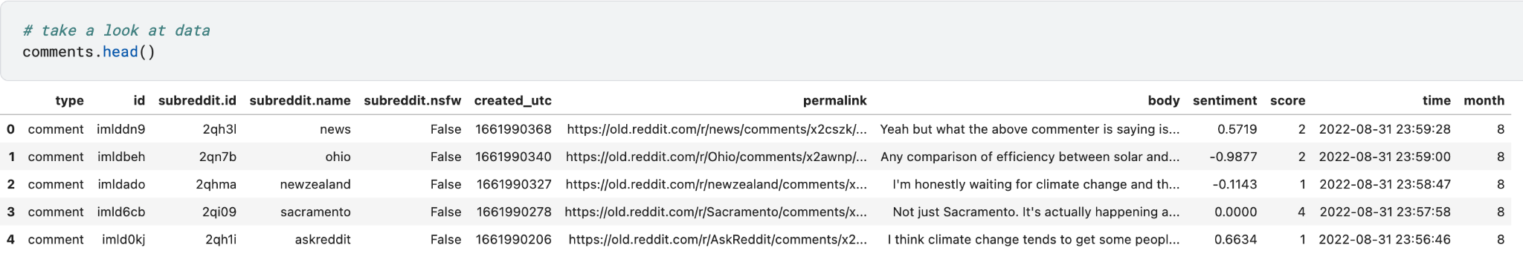
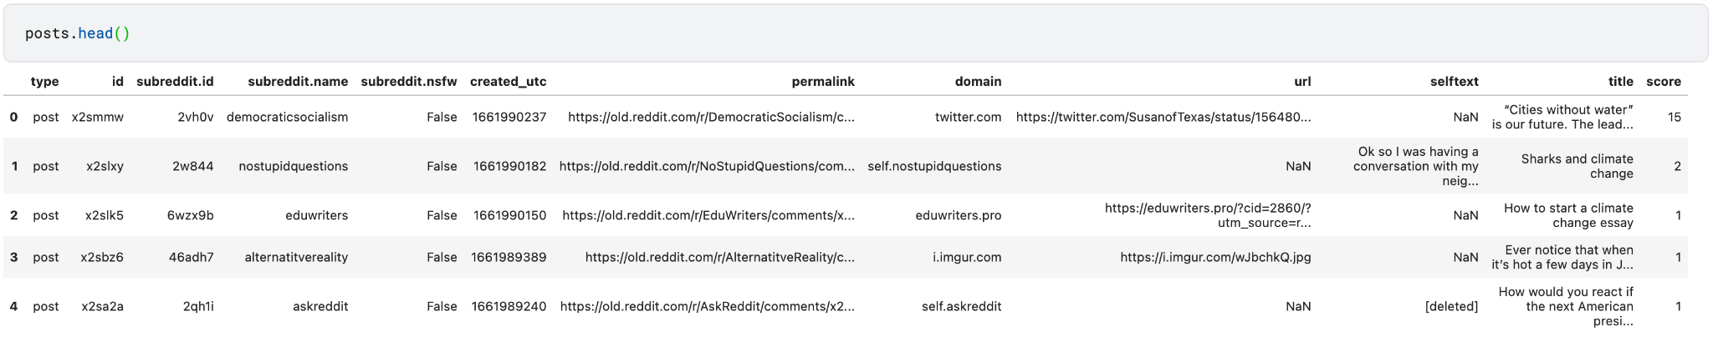
Kaggle Reddit Climate Change Dataset

Slide 4
Steps:
Extracting date and time from the dataset. The information was encoded in UTC format, and required conversion to Python datetime format.
Understanding how to extract entities from texts and find out their topics using spaCy and n-grams frequency distributions.
Data visualizations: When we tried to visualize the climate change data, it is showing in a very close plane. We used plotly to put it in scatter plot.

Slide 5
Month Extraction & Sentiment Scores

Slide 6
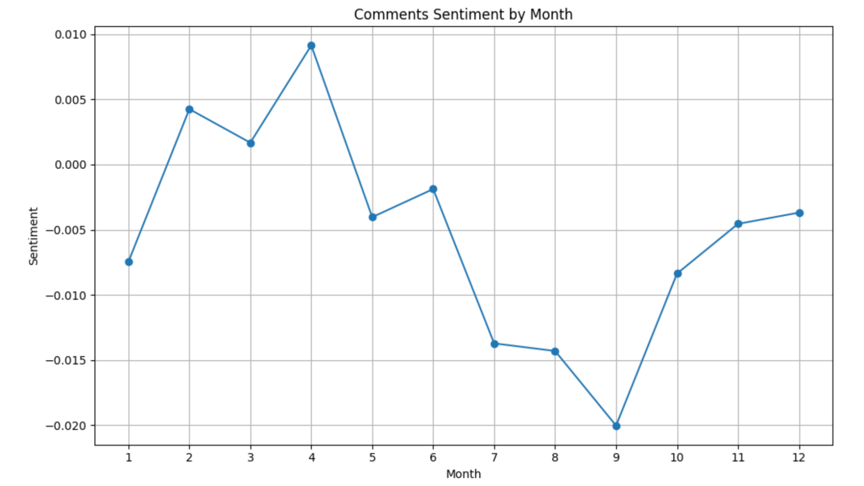
Monthly Average Sentiment on Comments

Slide 7
Topic Clustering

Slide 8
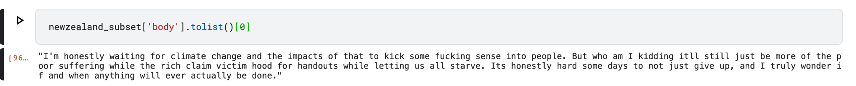
Deeper Look

Slide 9
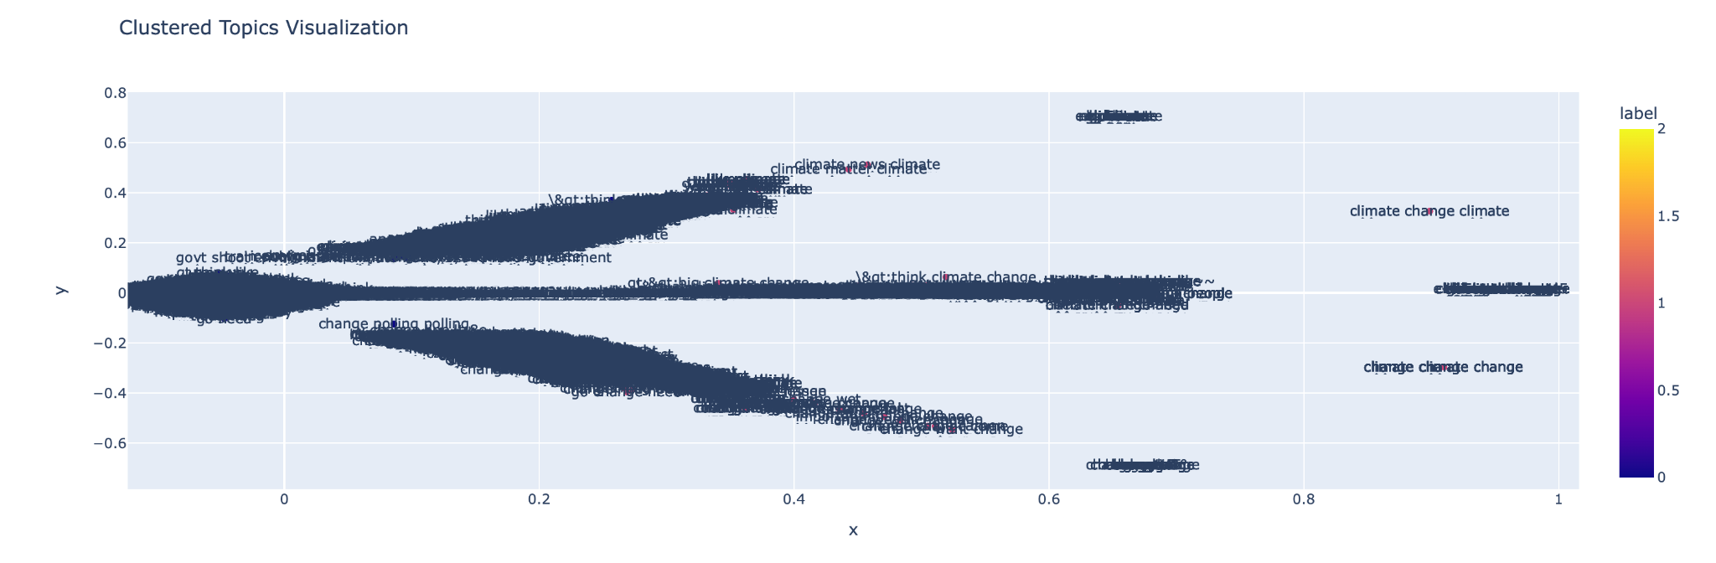
Frequent Topics by Clusters

Slide 10
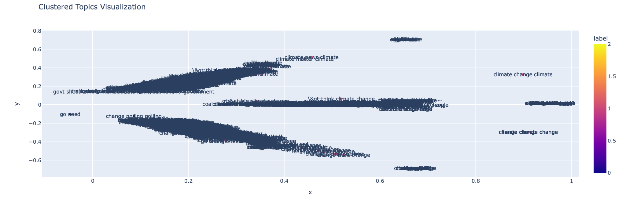
Cleaned Frequent Topics by Clusters

Slide 11
Conclusion:
Overall, we were happy to have worked together and delved deep into the dataset. Thank you to Fannie Mae and Technica for this challenge!
Within less than 24 hours, we were able to:
Leverage NLP and data cleaning to gain more insight into the data
Experience first-hand the hurdles that come with solving real world problem and how to blend our skills to solve them

Slide 12
Future Considerations
Graph data — Neo4j:
Data can be converted to graph data to create clusters
Improved sentiment analysis:
Compute our own sentiment values on comments and perform the same analysis
Build pipeline & scale up analysis:
Right now, we subsetted the original 20GB data to achieve the results
Moving on, we would build a pipeline to perform our analysis on the entire dataset with GPU

